Slide 1
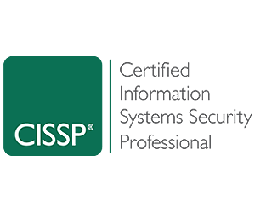
Introduction
Suraj Ghimire
CISSP Certified
10 yrs of experience in Cedar Gate
Quality Control
Quality Assurance
Data Analysis
Project Manager
Cybersecurity

Slide 2
Soft Security
GRC
What is it?

Slide 3
Governance
Are you liable?
Whether you are a small, medium or large financial, banking, Health Care Provider accessing non-public information and handling customer data comes with a responsibility and obligation
Cybersecurity Program
Polices and Procedures
Audit and monitoring
Data Classification
Incident Response
Good Pragmatics while drafting policy
Use trusted source, standards like ISO/IEC, NIST, HIPAA, journals etc.
Policy doesn’t match with your organization, that’s the problem

Slide 4

Governance
Why Governance?
Abide by laws, regulations and contracts
Inclination towards company core values, aims and vision
Regulation focuses on
Protection of customer information
Protection of information technology systems of regulated entities
Regulation requires
The cybersecurity plan to address ongoing cyber risks, threats and vulnerabilities.
Access the risk, build the cybersecurity program to mitigate the risks
Annual certification confirming compliance

Slide 5

Risk
Understanding or defining the Risk varies with the organization
Risk Management
Risk Assessment
Risk Tolerance
Risk Appetite
Risk Register
Forget about the terminologies. What’s crucial?
Understanding you domain, Asset Identification and Prioritization, Strategic Alignment
Vulnerability Assessment, BCP DR and BIA
Risk does not only posses in applications, database or networks
Consider potential threats from supply chain, dubster diving, tailgaiting, media sanitization and physical security equally

Slide 6
Risk
What is the first thing you do to understand the security posture of the organization?
Check the Risk Assessment
Remember you are not the one to make decisions or treat risk.
There’s a Senior Management for that task.

Slide 7
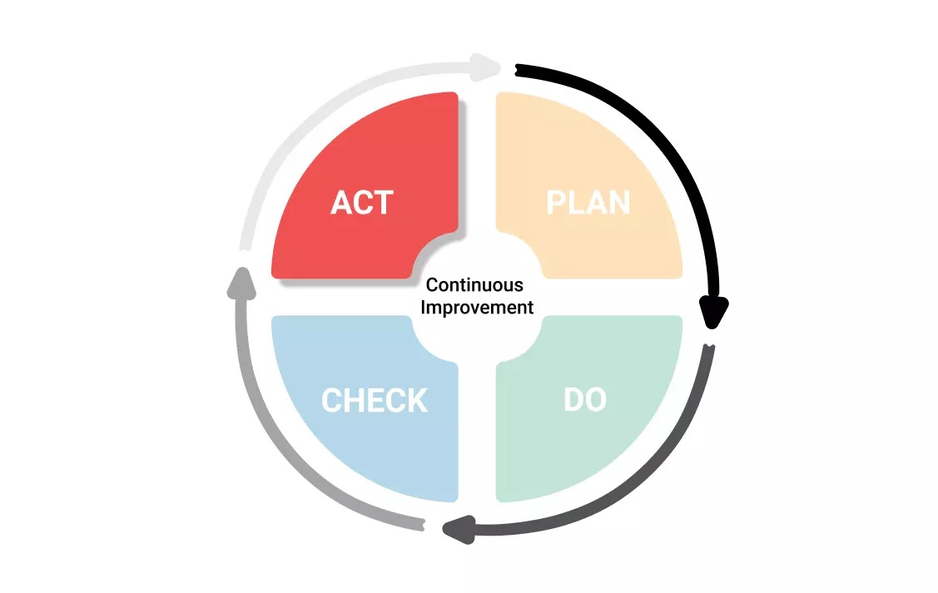
What’s the End Game?
Reduce risk
How to do it?
Know your threat landscape
Reduce attack surface
Continuous Patching
Stay vigilent

Slide 8
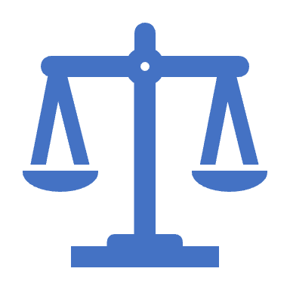
Compliance
Rules and Regulations (Medical, Financial etc.)
Laws
Contracts and agreements (SLA, BAA, etc)
Ethics

Slide 9

Governance
Audits
Why? Are you responsible for ensuring compliance with applicable statutory, regulatory and contractual requirements?
Gap assessment and remediation
Fines and Penalites involved could be minimized or avoided.
Internal audit and assessment before the external audit. Get Prepared.
Complimentary Organizational Roles
Privacy Officer or Privacy and Security Officer
Compliance Officer or Security and Compliance Officer
Physical Security Officer or Information Security Officer

Slide 10

SETA
Weakest form of security is Password
Humans are the weakest
Physical Security is the first line of defence
Training
Awareness
Education

Slide 11

Senior Management Roles
Top down is the best approach
Oversight and authorization
Fudiciary, legal and regulatory responsibilites
Vet document
Decisions and Approvals
They are ultimately responsible for security
Standard of due care and due diligence
And finally, allocate/approve budgets

Slide 12

Due Care and Due Diligence
Security should be embedded as the DNA in the process
Secure by design principle
Aware Users regularly
Create and follow procedures and baselines
Conduct table top exercises to mimic the real attack scenario and learn from it
Conduct regular tests like BCP /DR and Risk Assessment
Always stay on the top of the cybersecurity hot trends and news
Keep an eye on zero day vulnerabilities and critical patches
As long as your system is alive, you are vulnerable

Slide 13
Some Facts
Why similar attacks remain in the OWASP top 10
XSS, injection, IAMs, misconfigurations .....
Ransomware Attacks
Double attack variation is getting popular
Humans are social engineered; in layman terms they are fooled
Violation of laws, regulations and contracts is costing organizations a lot
Solution
User Awareness and Training
Human Firewall
Establish and follow SDLC (System Development Life Cycle)
Laws: THINK GLOBAL OBEY LOCAL
Understand Trans-Border data flow. Data jurisdictions matters

Slide 14
Conclusion
With lots of standalone and cloud Cybersecurity services available these days even with AI technologies, the GRC is getting lots of popularity.
You can have a very powerful DLP, IDS, IPS, Antivirus, SIEM, IRR (Incident Response Retainer), MSSP (Managed Security Service Provider), MDM, Asset Management, Patch Management, Code Scanning and other hi-tech tools and techniques
If you have any sign of breach or compromise;
IDS and IPS will be able to solve it
You can opt in for 24*7*365 days of real-time log monitoring services and seek for their expert opinion
IRR will guide you throughout the crisis and recover your business/services as much as possible
But the crucial thing you need is
Senior Management Support
Security Culture
Prepare your employees for the worst
Source of Truth; check for compliance
Zero Trust Architecture (“trust nothing, validate everything”)

